Slide 1
Changes in Videos

Slide 2
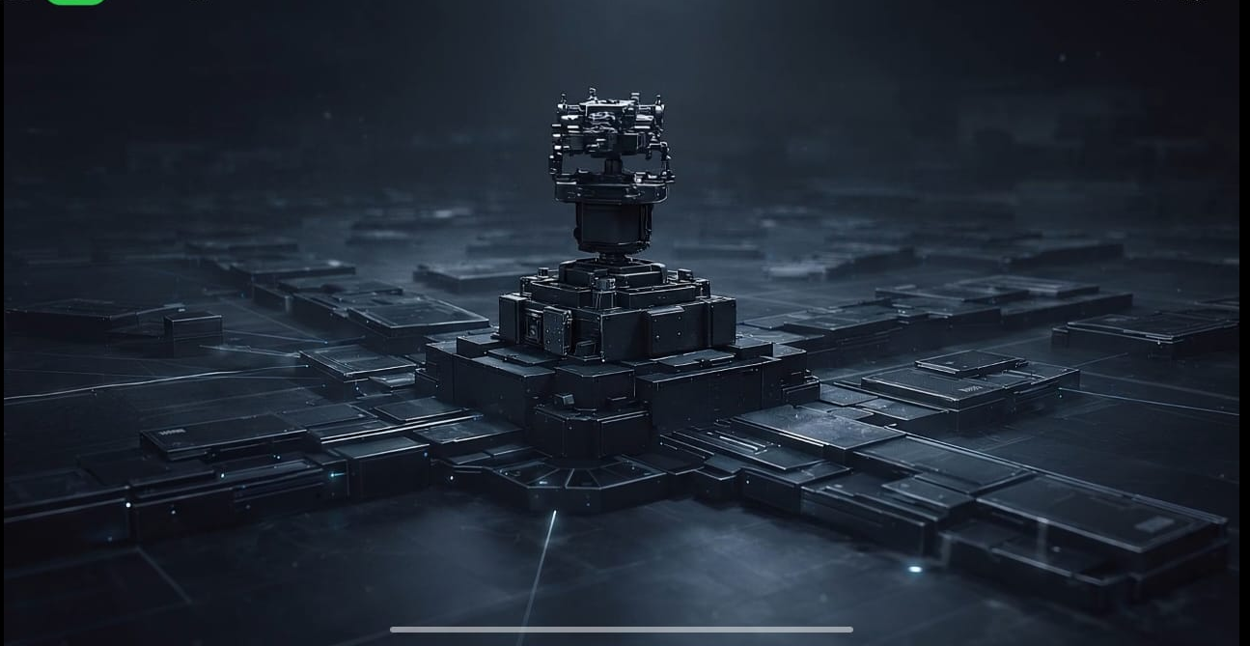
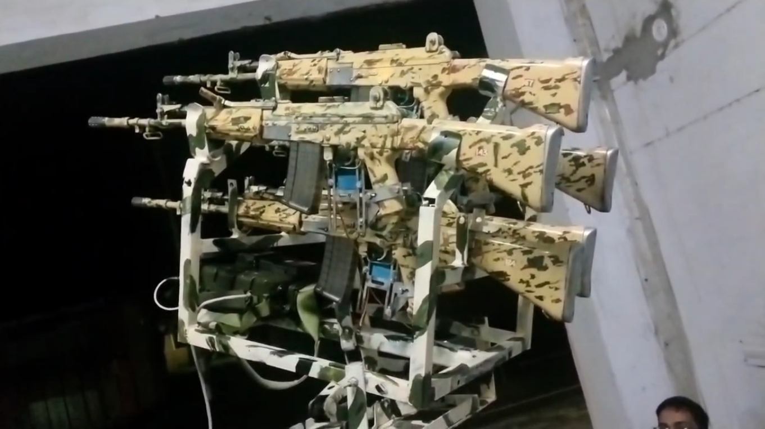
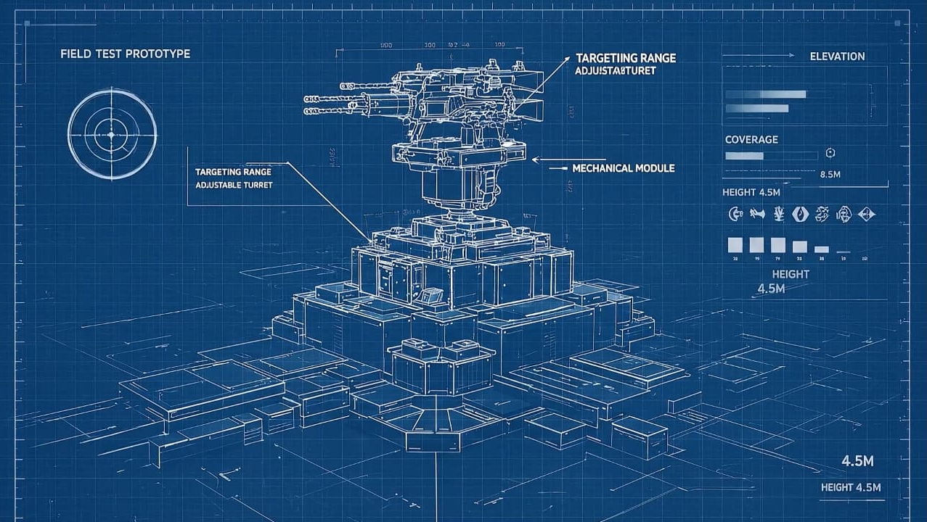
Change with real Product
Remove
Refer video1 if possible

Slide 3
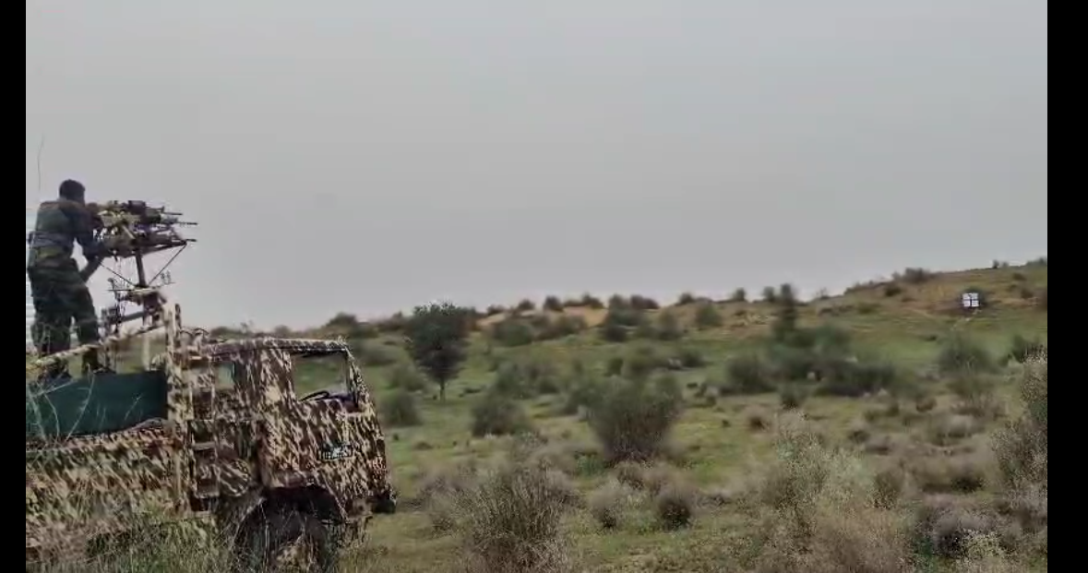
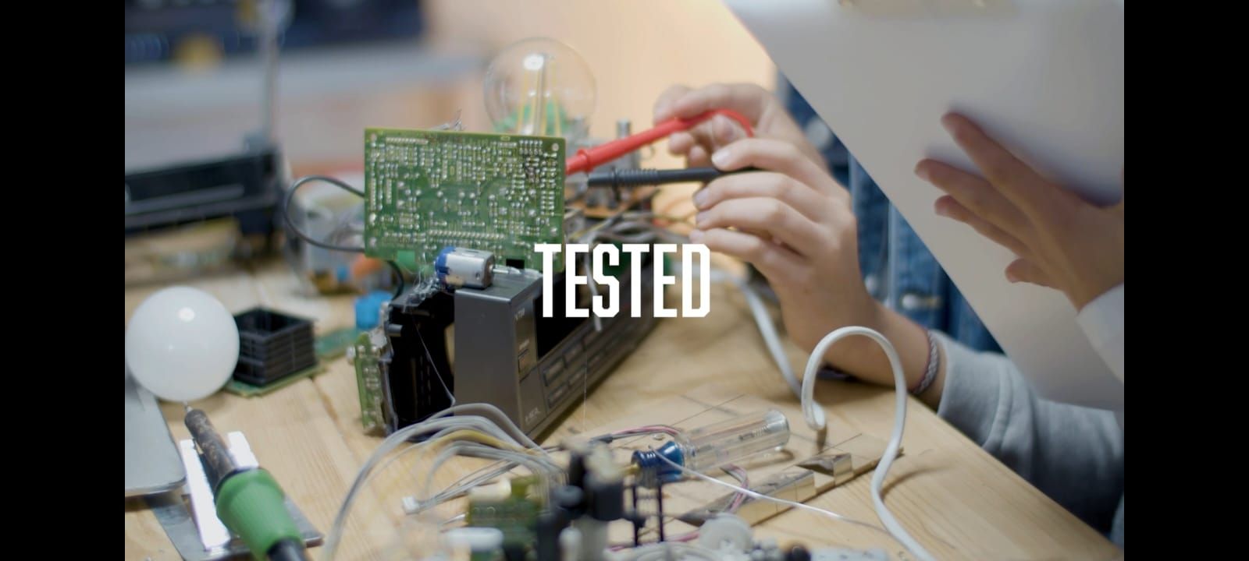
Change this short video with Video 3
Re-Text with :- On Field Tested
If possible remove Red circle or Crop that part
Enhance video Quality if possible

Slide 4
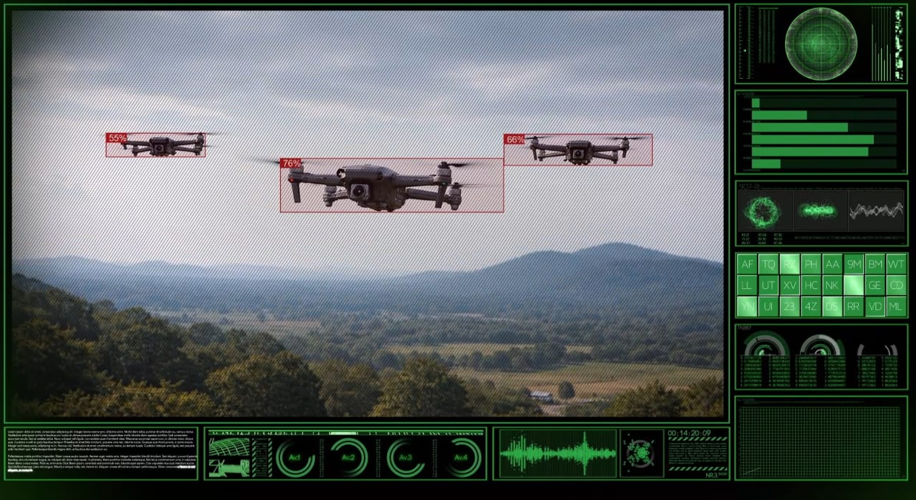
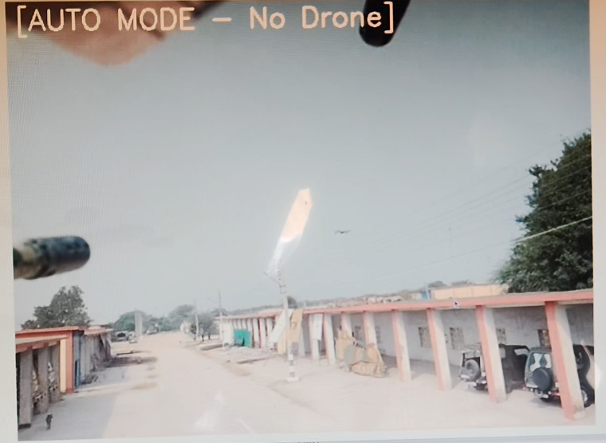
Change this with Video 8
try to add shorts of video 8 where system is moving as drone move

Slide 5
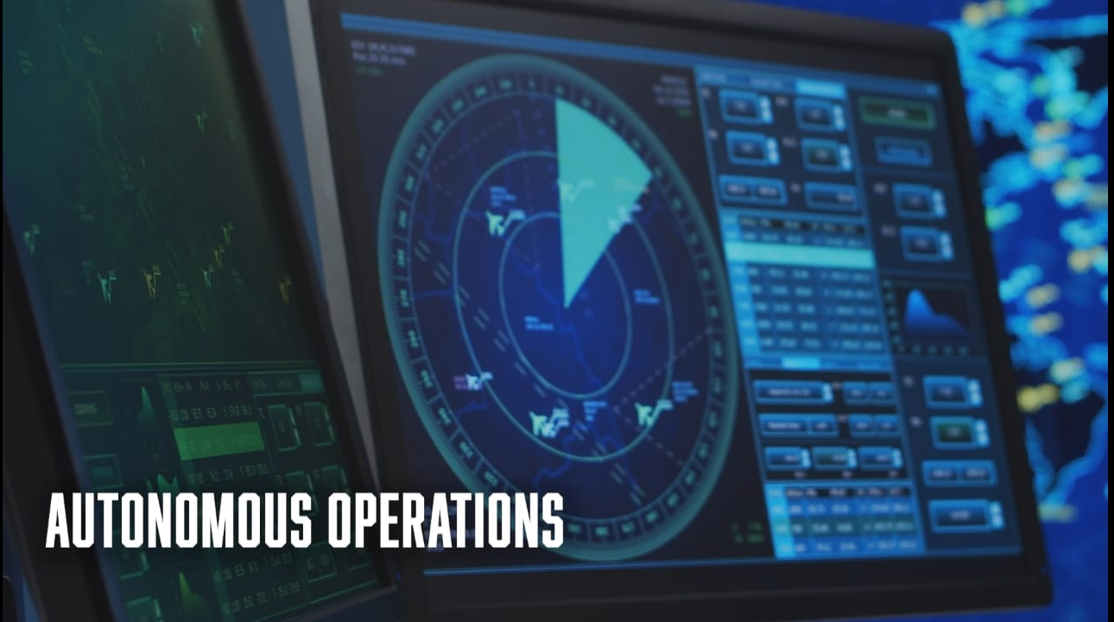
Change with Video 7
In Autonomous Operation change background video with video 7 and try to add shorts of video 7 of time 00:30 to 00:40 Time frame of video

Slide 6
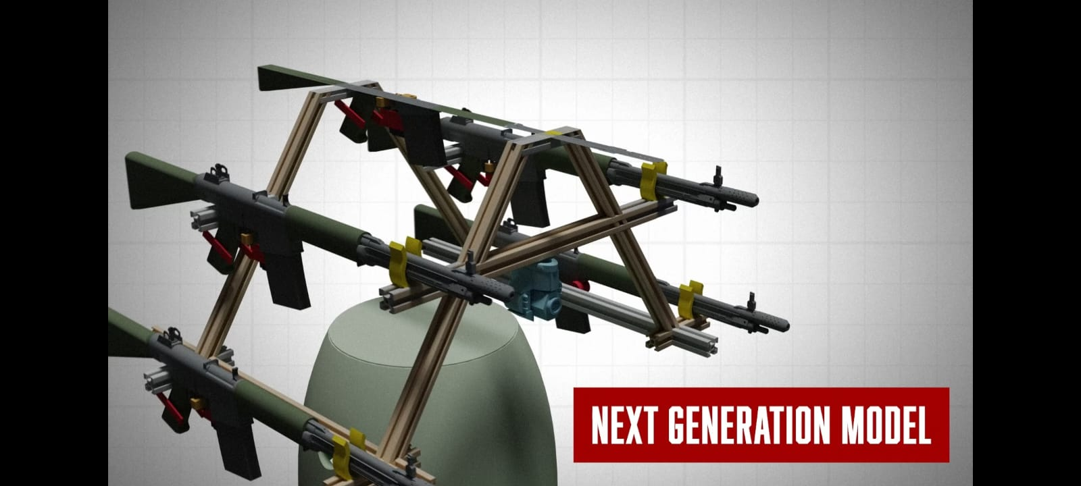
Change with new OBJ file Next Gen part 2
Complete system is not visible

Slide 7
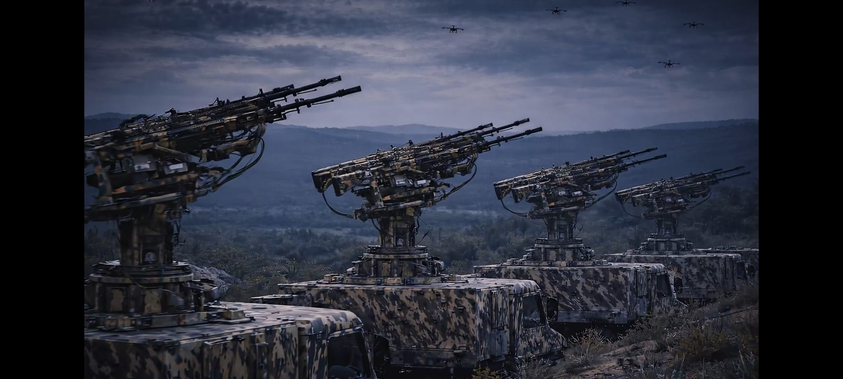
Change with some other AI image
Lets Discuss on call for this change

Slide 8
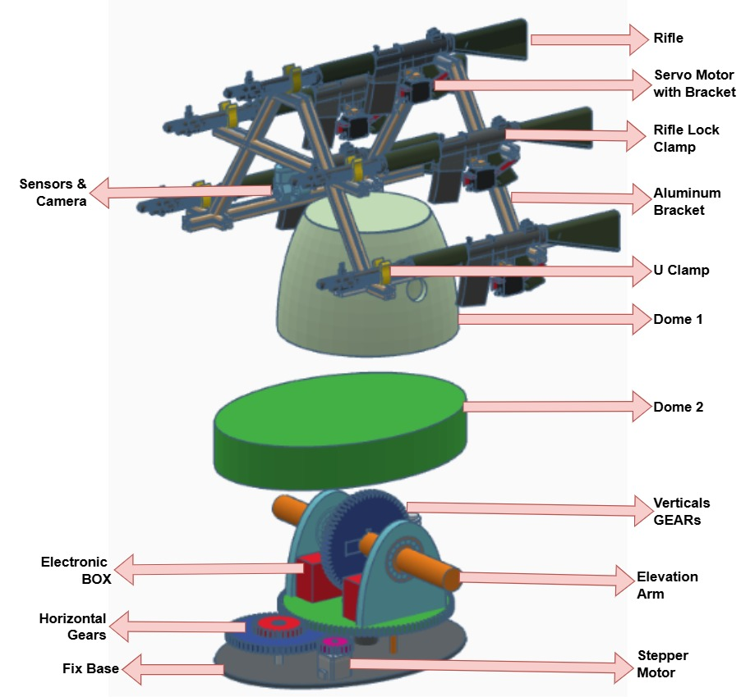
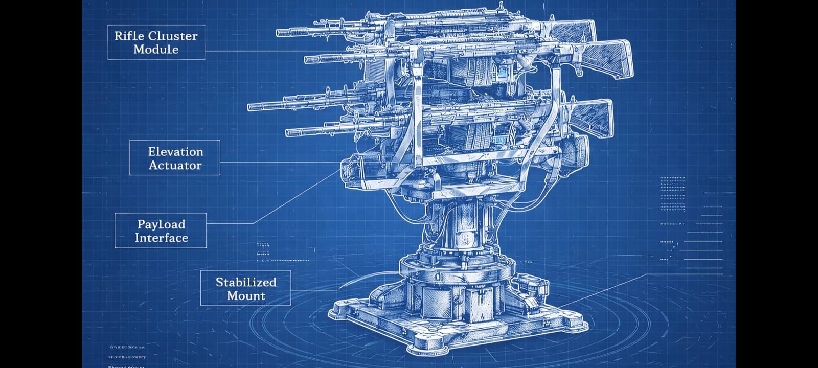
Change this with Assembly Image
With help of AI try to recreate complete assembly if not possible add this image

